Slide 1

PYTHON PROJECT
Covid-19 Dataset Analysis And Visualization

Slide 2
Contents
Introduction
Objectives
Tables for dataset
Output
Source code
Summary

Slide 3

Introduction
The project will develop a systematic module to analyze and visualize the data set of Covid-19.
The problem statement we considered to solve was – delineate the Covid-19 set data and categorize it into various sections for finer comprehension. The applicability and efficiency standpoint of our program is remarkable as we have shown many aspects by extracting information from the data. We have shown the dips and rises in the data and made it easy for us to process the information. By the means of using NumPy, Pandas, Matplotlib and Seaborn we have achieved this result.

Slide 4


As stated earlier our main objective was to process data in a resourceful way so that we could extract more competent conclusions. So, we well-thought-out about our aims and added the following subjects into our project – 1.Created a custom table for better understanding the data where We are showing the most important information like Mortality Rate and Recovery Rate and further categorizing it under respective states. 2.We are presenting Active cases and cured cases of each state. 3.We are also portraying the death toll caused by the pandemic in each state of India. 4.Top 10 states with active cases are being portrayed. 5. Top 10 states with highest deaths cases are also being portrayed.
OBJECTIVES

Slide 5
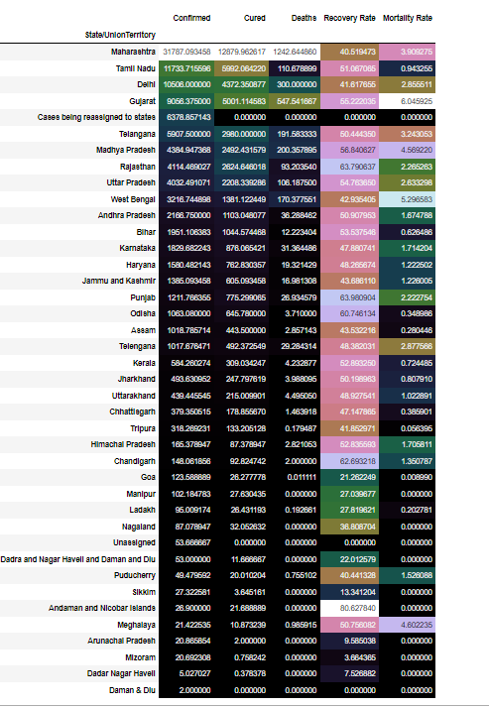
CUSTOM TABLE FOR THE DATASET

Slide 6
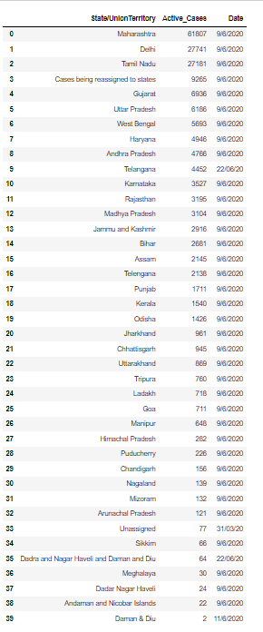
Active and Cured Cases State wise

Slide 7
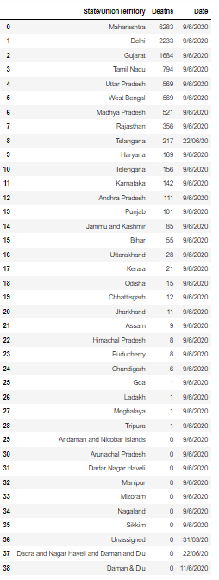
Death toll caused by the pandemic in each state of India.

Slide 8
Source Code
import pandas as pd
import numpy as np
import matplotlib.pyplot as plt
import seaborn as sns
covid_df=pd.read_csv('covid_19_india.csv')
covid_df
covid_df['State/UnionTerritory'].unique()
#Checking the unique states listed in the Dataset
covid_df.shape
#shape of the dataframe
covid_df.head(5)
#first five data
covid_df.tail(5)
#last five data
covid_df.info()
#Information of dataset
covid_df.describe()
# describe the dataset
covid_df=covid_df.drop(['Sno','Time','ConfirmedIndianNatioal,'ConfirmedForeignNational'],axis=1)
covid_df.head()
covid_df['Active_Cases']=covid_df['Confirmed']-(covid_df['Cured']+ covid_df['Deaths'])

Slide 9
covid_df.head()
covid_df.tail()
statewise=pd.pivot_table(covid_df,values=['Confirmed','Deaths','Cured'],index='State/UnionTerritory')
statewise['Recovery Rate']=statewise['Cured']*100/statewise['Confirmed']
statewise['Mortality Rate']=statewise['Deaths']*100/statewise['Confirmed']
statewise=statewise.sort_values(by='Confirmed',ascending=False)
statewise.style.background_gradient(cmap='cubehelix')
top_10_active_cases=covid_df.groupby(by='State/UnionTerritory').max()[['Active_Cases','Date']].sort_values(by=['Active_Cases','Date'],ascending=False).reset_index()
top_10_active_cases
top_10_cured_cases=covid_df.groupby(by='State/UnionTerritory').max()[['Cured','Date']].sort_values(by=['Cured','Date'],ascending=False).reset_index()
top_10_cured_cases
index_names = covid_df[covid_df['State/UnionTerritory'] == 'Cases being reassigned to states' ].index
covid_df.drop(index_names,inplace=True)

Slide 10
top_10_active_cases=covid_df.groupby(by='State/UnionTerritory').max()[['Active_Cases','Date']].sort_values(by=['Active_Cases','Date'],ascending=False).reset_index()
fig=plt.figure(figsize=(16,10))
plt.title("Top 10 states with most active cases in India",size=25)
ax=sns.barplot(data=top_10_active_cases[:10],y="Active_Cases",x="State/UnionTerritory",linewidth=3,edgecolor='red')
plt.xlabel("States")
plt.ylabel("Total Active Cases")
plt.show()
top_10_deaths=covid_df.groupby(by='State/UnionTerritory').max()[['Deaths','Date']].sort_values(by=['Deaths','Date'],ascending=False).reset_index()
top_10_deaths
top_10_deaths=covid_df.groupby(by='State/UnionTerritory').max()[['Deaths','Date']].sort_values(by=['Deaths','Date'],ascending=False).reset_index()
fig=plt.figure(figsize=(16,10))
plt.title("Top 10 states with most deaths in India",size=25)
ax=sns.barplot(data=top_10_deaths[:12],y="Deaths",x="State/UnionTerritory",linewidth=3,edgecolor='black')
plt.xlabel("States")
plt.ylabel("Total Deaths")
plt.show()

Slide 11
Visualization using graphs
OUTPUT

Slide 12
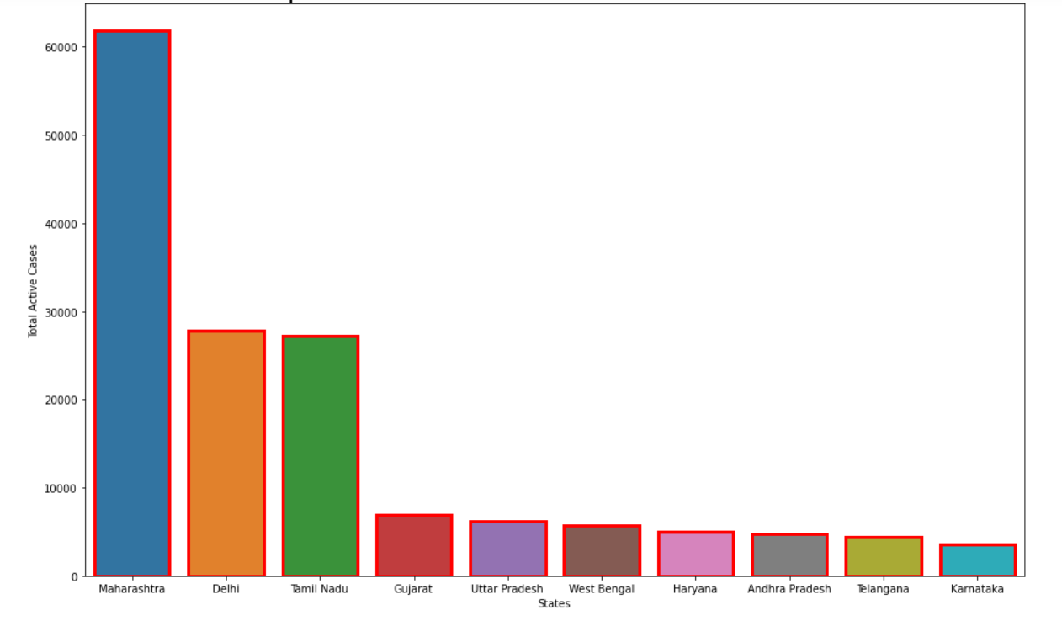
Top 10 states with active cases

Slide 13
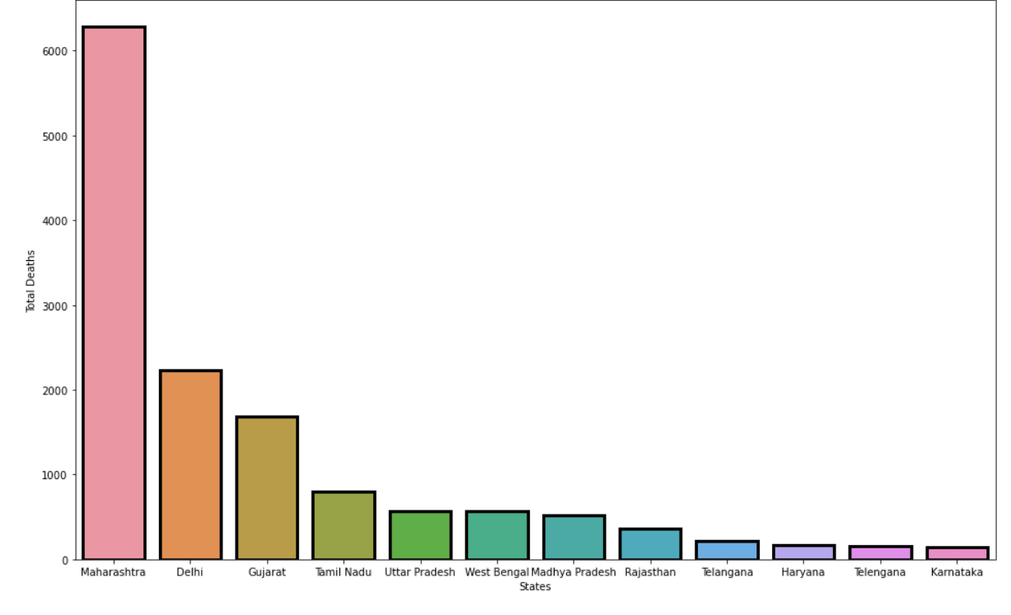
Top 10 states with most Death Cases

Slide 14


Summary
This project will give you a idea about the Covid-19 data in India in terms of Confirmed cases, deaths, active cases and recoveries. In this project, we are using data of different states to finally visualize the changes in the cases happened over a given period of time in India.

